Slide 1
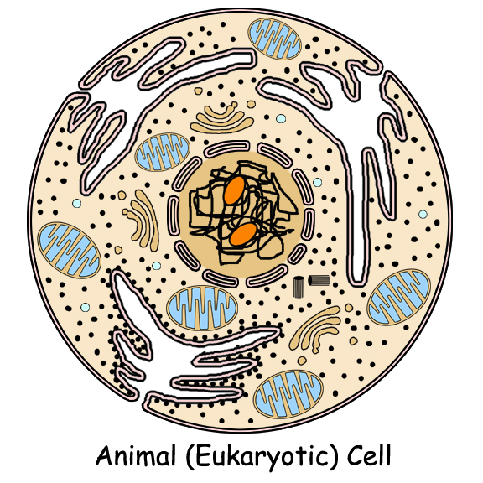
Two Basic Cell Types: Prokaryotic vs. Eukaryotic Cells

Slide 2
Two Basic Types
Remember….cells are the basic unit of life for ALL living things.
There are two basic types of cells:
Prokaryotic cells – found in bacteria
Eukaryotic cells – found in protists, fungi, plants and animals

Slide 3
Characteristics Shared
Perform the same basic functions
Surrounded by plasma membrane to control what enters and leaves the cell
“Filled” with cytoplasm
Contain ribosomes to make protein
Contain DNA to give the general instructions for the cell’s life

Slide 4
What Makes Eukaryotic Cells Different?
Much larger
Much more complex
Contain a true nucleus to house the genetic material (DNA)
Linear DNA packaged into chromatin found inside the nucleus
Contains specialized structures in the cytoplasm called organelles to carry out various functions
Not all have a cell wall

Slide 5
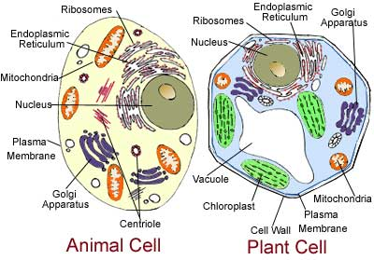
Eukaryotic Cells

Slide 6
What Makes Prokaryotic Cells Different?
Much smaller
Less complex
No true nucleus
Circular DNA that is found in the cytoplasm
No organelles found in the cytoplasm
Surrounded by a cell wall

Slide 7
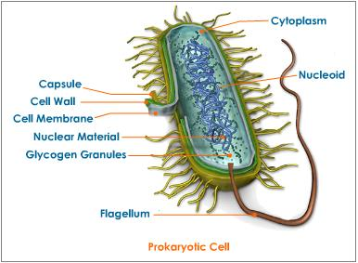
Prokaryotic Cell

Slide 9
What does size have to do with it?
Prokaryotic cells are much smaller than eukaryotic cells. Why?
Smaller surface area to volume allows nutrients to easily and quickly reach inner parts of the cell.
Eukaryotic cells are larger and can not pass nutrients as quickly. They require specialized organelles to:
carry out metabolism
provide energy
transport chemicals throughout the cell

Slide 10
Prokaryotic Cell
http://www.cellsalive.com/cells/bactcell.htm#top

